Slide 1
Reactive Extensions
(Rx, ReactiveX)
A teaser with practical examples

Slide 2
Important topics that will not be covered (since it is just a teaser)
Subjects
Observable.Create()
SubscribeOn()
ObserveOn()
“Hot” and “cold” observables
Schedulers
All existing LINQ operators

Slide 3
What is Rx?
The Reactive Extensions (Rx) is a library for composing asynchronous and event-based programs using observable sequences and LINQ-style query operators.
Using Rx, developers represent asynchronous data streams with Observables, query asynchronous data streams using LINQ operators, and parameterize the concurrency in the asynchronous data streams using Schedulers.
Schedulers
LINQ
Rx
Observables

Slide 4
Multiple platforms/languages (with different dialects)
C# Rx.NET
Java RxJava
JavaScript RxJS
C++ RxCpp
Scala RxScala
Kotlin RxKotlin
Swift RxSwift
Python RxPY
PHP RxPHP
etc.

Slide 5


The missing piece for representing sequence of events
 | Single return value | Multiple return values
Pull / Synchronous / Interactive | T | IEnumerable<T>
Push / Asynchronous / Reactive | Task<T> | IObservable<T>
Pull / Asynchronous / Interactive | Func<Task<T>> | IAsyncEnumerable<T>

Slide 6
Comparison with imperative programming
Functional, declarative
(Observables)
Imperative
(events and event handlers)
GetDataFromKeyboard()
.Skip(10)
.Take(5)
.Select(text => $"{text} has been transformed")
.Subscribe(text => Console.WriteLine(text));
int textEventCount = 0;
void KeyboardEventHandler(string text)
{
textEventCount++;
if (textEventCount <= 10 || textEventCount > 15)
return;
Console.WriteLine($"{text} has been transformed");
}
Less complex
Abstractions
Composable
More complex (for non-trivial problems)
Design patterns
Non-composable

Slide 7
Advantages compared to imperative programming
Intentional
Abstractions can be created by implementing functions (LINQ operators), thus preserving the original intention, instead of applying “design patterns”.
Concise
Less error-prone
The logic is represented inside well-named functions.
Composable
Extensible
Easy concurrency
Existing LINQ operators can be combined.
New LINQ operators can be introduced by combining existing ones or by creating them from scratch by using Observable.Create().
There is no shared state, so concurrency can be controlled and comprehended easily.
Less complex
Each logic is being kept inside its “box” (function), so we can focus on one logic at a time.
If we are dealing with one “box”, then we do not interfere with other boxes, since the different logics are being separated from each other.

Slide 8
Observable (IObservable)
Subscription
Subscribe
IObserver<T>
IObservable<T>
Notifications

Slide 9
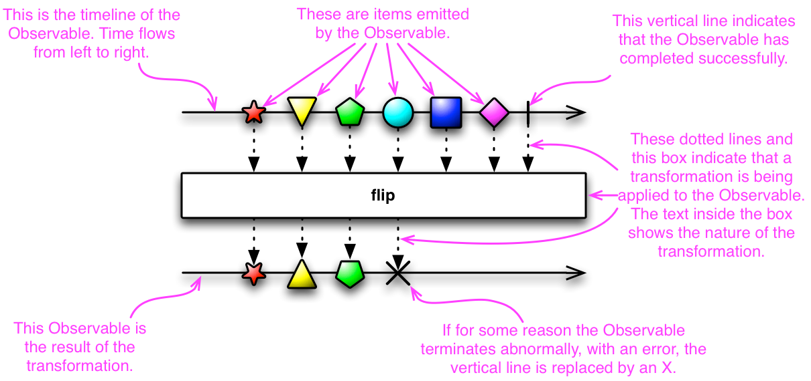
Marble diagrams

Slide 10
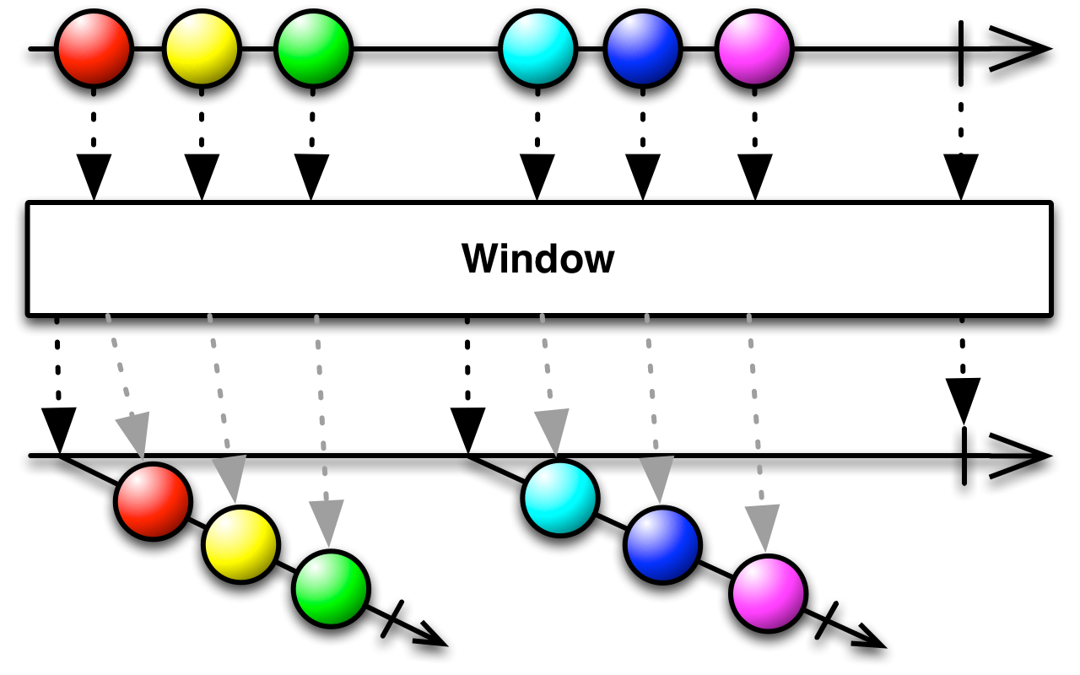
Marble diagrams

Slide 11
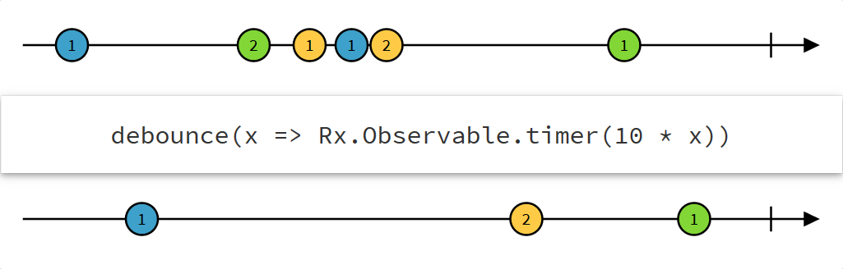
Marble diagrams

Slide 12
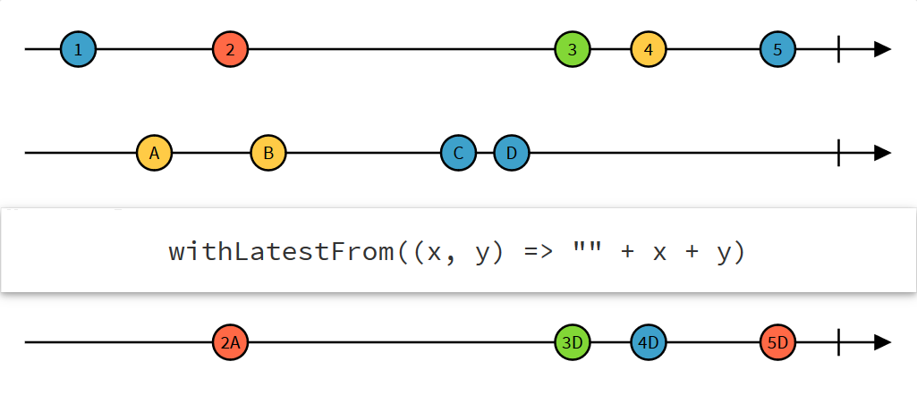
Marble diagrams

Slide 13
Observer pattern
public interface IObservable<out T>
{
IDisposable Subscribe(IObserver<T> observer);
}
public interface IObserver<in T>
{
void OnNext(T value);
void OnError(Exception error);
void OnCompleted();
}

Slide 14
Simple examples
Subscribe
Dump
Where
Window
GroupBy (query syntax)

Slide 15
Duality
Observer pattern
Iterator pattern
public interface IObservable<out T>
{
IDisposable Subscribe(IObserver<T> observer);
}
public interface IObserver<in T>
{
void OnNext(T value);
void OnError(Exception error);
void OnCompleted();
}
public interface IEnumerable<out T>
{
IEnumerator<T> GetEnumerator();
} // simplified
public interface IEnumerator<out T> : IDisposable
{
T Current { get; }
bool MoveNext(); // can throw exception
void Reset();
} // simplified

Slide 16
Duality
Observable
Iterable
GetDataFromKeyboard()
.Skip(10)
.Take(5)
.Select(text => $"{text} has been transformed")
.Subscribe(text => Console.WriteLine(text));
GetDataFromLocalMemory()
.Skip(10)
.Take(5)
.Select(text => $"{text} has been transformed")
.ForEach(text => Console.WriteLine(text));

Slide 17
Duality
Observer pattern
Iterator pattern
IEnumerable
IObservable
IObserver
LINQ to Events
IEnumerator
LINQ to Objects

Slide 18
Practical example: ReactiveTextBox
C# example
IObservable<string[]> searchResults =
texts
.Throttle(_throttleDueTime)
.DistinctUntilChanged()
.Select(text =>
Observable.FromAsync(async ct => await SearchEngine.Search(text, ct))
.Timeout(_timeoutDueTime)
.Retry(_retryCount)
.Catch((TimeoutException ex) => Observable.Return(new[] { "<< TIMEOUT >>" }))
.Catch((Exception ex) => Observable.Return(new[] { "<< ERROR >>" }))
.Amb(Cancellations.FirstAsync().Select(unit => new[] { "<< CANCEL >>" }))
)
.Switch();

Slide 19
Practical example: ReactiveTextBox
JavaScript example
var searchResults = Rx.Observable.fromEvent($('#inputText'), 'keyup')
.map(e => e.target.value)
.debounce(500)
.distinctUntilChanged()
.map(text =>
Rx.Observable.fromPromise(searchWikipedia(text))
.timeout(3000)
.retry(3)
.catch(function(ex) {
if (ex instanceof Rx.TimeoutError) return Rx.Observable.return(["<< TIMEOUT >>"]);
else return Rx.Observable.return(["<< ERROR >>"]);
})
.amb(Rx.Observable.fromEvent($('#cancelButton'), 'click').map(unit => ["<< CANCEL >>"]))
)
.switch();

Slide 20
Practical example: Wave detection with Kinect
Example
Example with methods
var rapidHandMovements =
(
from handPositionBuffer in handPositions.Buffer(timeSpan: TimeSpan.FromMilliseconds(100))
where handPositionBuffer.Any()
let xFirst = handPositionBuffer.First()
let xLast = handPositionBuffer.Last()
let direction = Math.Abs(xLast - xFirst) < 0.1 ? Direction.None:
xFirst < xLast ? Direction.Right:
Direction.Left
where direction != Direction.None
select direction
).Timestamp();
var waves =
rapidHandMovements
.DistinctUntilChanged()
.Timestamp()
.Buffer(count: 5, skip: 1)
.Where(buffer => buffer.Last().Timestamp - buffer.First().Timestamp < TimeSpan.FromSeconds(2))
.Timestamp()
.Select((buffer, index) => $"Waving #{index} {buffer.Timestamp.TimeOfDay}");

Slide 21
Practical example: Concurrency and retry
Example
numbers
.Select(number => Observable.FromAsync(async () => await CalculateLongRunningTask1(number)))
.Select(number => Observable.FromAsync(async () => await CalculateLongRunningTask2(await number)))
.Merge(10)
.Select(number => Observable.FromAsync(async () => await CalculateLongRunningTask3(number)))
.Merge(5)
numbers
.StagedMerge(
timeSpan: TimeSpan.FromSeconds(5),
count: 5,
separateStages: true,
stage1: number => Observable.FromAsync(() => CalculateLongRunningTask1(number)),
stage2: number => Observable.FromAsync(() => CalculateLongRunningTask2(number)))
numbers
.Select(number => Observable.FromAsync(() => CalculateLongRunningTask1(number)))
.MergeWithRetry(5, minRetryDelay: TimeSpan.FromSeconds(3))
numbers
.Latest()
.Select(number => Observable.FromAsync(() => CalculateLongRunningTask1(number)))
.Concat()

Slide 22
Queryable observable (IQbservable)
Subscription
Subscribe
Server
IQbservable<T>
Client
IObserver<T>
Composition
Notifications

Slide 23
LINQ to Cloud
Subscription
Subscribe
Server
IQbservable<T>
Composition
Client
IObserver<T>
Notifications

Slide 24
Qbservable
public interface IQbservable
{
Type ElementType { get; }
Expression Expression { get; }
IQbservableProvider Provider { get; }
}
public interface IQbservable<out T> : IQbservable, IObservable<T>
{
}
public interface IQbservableProvider
{
IQbservable<TResult> CreateQuery<TResult>(Expression expression);
}

Slide 25
Practical example: Qactive: LINQ to Cloud – IQbservable Over the Wire
Server
var source = Observable.Interval(TimeSpan.FromMilliseconds(100))
.Select(number => Tuple.Create($"Message: '{number}'", number));
var service = source
.ServeQbservableTcp(new IPEndPoint(IPAddress.Any, 3205), QbservableServiceOptions.Unrestricted);
Client
var client = new TcpQbservableClient<Tuple<string, long>>(new IPEndPoint(IPAddress.Parse("1.2.3.4"), 3205));
var query =
from item in client
.Query()
.Do(value => Console.WriteLine($"I am running 'Console.WriteLine': {value}"))
where item.Item2 % 30 == 0
select item;

Slide 26
Duality
Qbservable
Queryable
public interface IQbservable
{
Type ElementType { get; }
Expression Expression { get; }
IQbservableProvider Provider { get; }
}
public interface IQbservable<out T> : IQbservable, IObservable<T>
{
}
public interface IQbservableProvider
{
IQbservable<TResult> CreateQuery<TResult>(Expression expression);
}
public interface IQueryable
{
Type ElementType { get; }
Expression Expression { get; }
IQueryProvider Provider { get; }
} // simplified
public interface IQueryable<out T> : IQueryable, IEnumerable<T>
{
} // simplified
public interface IQueryProvider
{
IQbservable<TResult> CreateQuery<TResult>(Expression expression);
} // simplified

Slide 27
Duality
Qbservable
Queryable
GetDataFromNetwork()
.Skip(10)
.Take(5)
.Select(text => $"{text} has been transformed")
.Subscribe(text => Console.WriteLine(text));
GetDataFromDatabase()
.Skip(10)
.Take(5)
.Select(text => $"{text} has been transformed")
.ForEach(text => Console.WriteLine(text));

Slide 28
Duality
Qbservable
Queryable
IQueryable
IQbservable
IQbservableProvider
LINQ to WQL LINQ to Cloud
IQueryProvider
LINQ to SQL LINQ to Entities

Slide 29
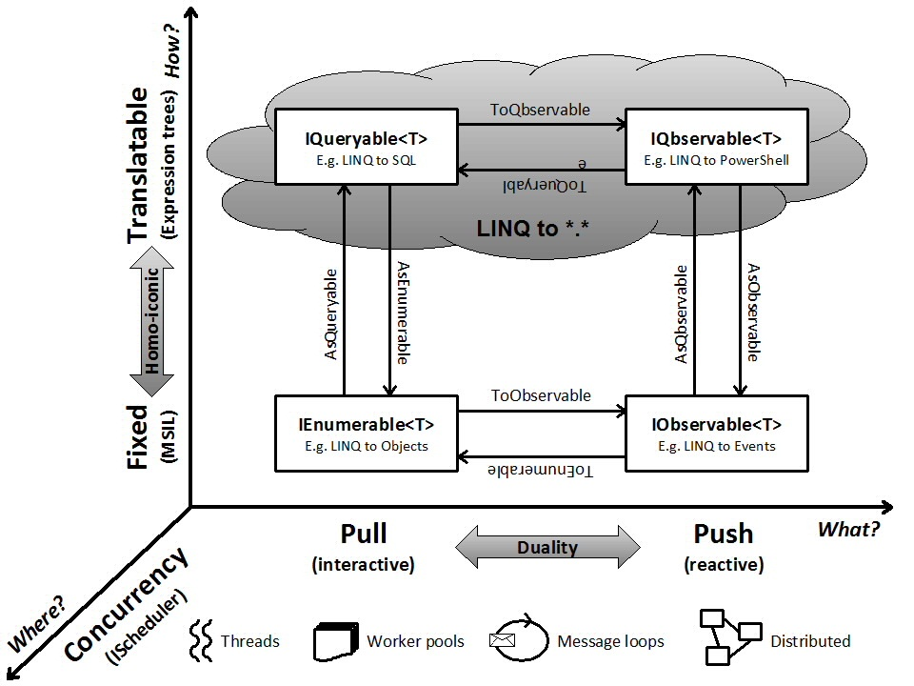
Duality, homoiconicity
https://channel9.msdn.com/Shows/Going+Deep/Bart-De-Smet-Observations-on-IQbservable-The-Dual-of-IQueryable

Slide 30
Duality, homoiconicity
What the data model is you're targeting. Here we find pull-based versus push-based models. Their relationship is based on duality. Transformations exist between those worlds (e.g. ToEnumerable).
Where you execute operations that drive your queries (sensu lato). Certain operators need concurrency. This is where scheduling and the IScheduler interface come in. Operators exist to hop between concurrency domains (e.g. ObserveOn).
How a query expression needs to execute. Either verbatim (IL) or translatable (expression trees). Their relationship is based on homoiconicity. Conversions exist between both representations (e.g. AsQueryable).
https://stackoverflow.com/questions/1179296/will-there-be-iqueryable-like-additions-to-iobservable-net-rx/2839698#2839698

Slide 31
References
ReactiveX
Reactive-Extensions/Rx.NET
System.Reactive NuGet
Introduction to Rx
101 Rx Samples
Curing Your Event Processing Blues with Reactive Extensions (Rx)
Your Mouse is a Database
RxJS Marbles
http://reactivex.io/
https://github.com/Reactive-Extensions/Rx.NET
https://www.nuget.org/packages/System.Reactive
http://www.introtorx.com
http://rxwiki.wikidot.com/101samples
https://channel9.msdn.com/Events/TechEd/Europe/2012/DEV413
http://queue.acm.org/detail.cfm?id=2169076
http://rxmarbles.com/
http://josemigueltorres.net/index.php/ienumerableiobservable-duality
Duality of IEnumerable/IObservable
http://bartdesmet.net/blogs/bart/archive/2009/12/25/more-linq-with-system-interactive-getting-started.aspx
More LINQ with System.Interactive – Getting Started
https://github.com/RxDave/Qactive
Qactive – A reactive queryable observable framework
An evaluation of the Reactive Extensions (Rx)
http://www.sapientgovernmentservices.com/content/dam/sapient/sapientglobalmarkets/pdf/thought-leadership/reactive_extensions.pdf
https://channel9.msdn.com/Shows/Going+Deep/Bart-De-Smet-Observations-on-IQbservable-The-Dual-of-Iqueryable
Bart De Smet: Observations on IQbservable - The Dual of IQueryable
https://stackoverflow.com/questions/1179296/will-there-be-iqueryable-like-additions-to-iobservable-net-rx/2839698#2839698
IEnumerable, IQueryable, IObservable, IQbservable

